Slide 1



Employee Task Assignment System
SOA Project Review-1
Team Members
Under the Guidance of
Y.Shubharoop - 2420030566
Dr. Navyatha Ravi
M.Hanush - 2420030358
Professor
Suhaas - 2420030419
Department of Computer Science and Engineering
V.Pavan - 2420090023
KLH CSE Bowrampet Campus
Date: August 18, 2026

Slide 2

Outline of Project Work
Introduction: Overview of Task Assignment paradigms and the shift to Microservices.
Problem Gap Identification: Identifying what current systems lack in dynamic adaptability.
Literature Survey: Analysis of existing research and scheduling algorithms.
Innovation & Novelty: Fusing Genetic Algorithms with GRU models in a cloud-native mesh.
Problem Statement: Challenges in monolithic task management systems.
Feasibility & Project Plan: Execution timeline and phase milestones.
Research Objectives: Key goals utilizing SOA and predictive AI.
Conclusion & Future Work: Summary and potential expansions.

Slide 3

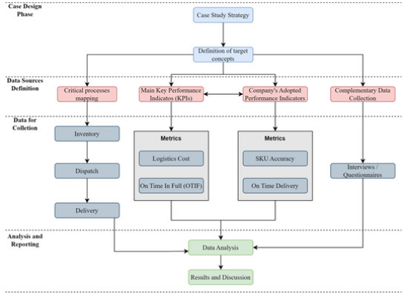
Introduction
Evolving Workforce Logistics
Effective task allocation is a vital factor in optimizing operational productivity and resource utilization within modern enterprises.
As organizations scale, the complexity of aligning the right personnel with the right tasks in real-time grows exponentially. Traditional models rely heavily on manual intervention or static, rigid rule-sets.
This project introduces a paradigm shift by leveraging Service-Oriented Architecture (SOA) to create an automated, intelligent, and highly scalable task assignment ecosystem.

Slide 4

Literature Survey
Authors & Year | Title of the Paper | Methodology | Inferences | Limitation / Gap
Chen et al. [1] 2023, IEEE Access | Microservice-based Dynamic Resource Allocation Framework | Docker swarm clustering with heuristic load balancing for enterprise task nodes. | Achieved 94% uptime and reduced latency by 30% over standard monolithic models. | Lacks intelligent predictive modeling for deadline slippage.
Kumar & Singh [2] 2024, Springer | Genetic Algorithms for Multi-Objective Task Scheduling | Non-dominated Sorting Genetic Algorithm (NSGA-II) for mapping skills to tasks. | Demonstrated superior accuracy in skill matching and minimizing operational costs. | Algorithm struggles with real-time dynamic node failures.
Zhang et al. [3] 2025, ACM | Predictive Analytics in HR Workflows using Deep Learning | Gated Recurrent Units (GRU) applied to historical employee performance logs. | Highly accurate (96.5%) in forecasting task completion timelines. | Was not integrated into a distributed microservice architecture.

Slide 5
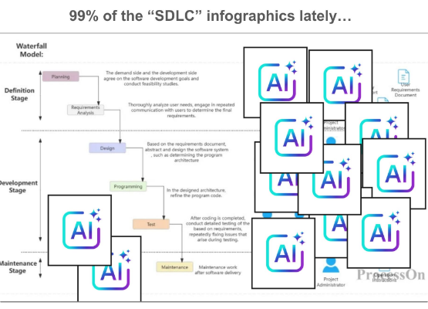
Problem Statement
The Bottleneck of Monolithic Systems
Traditional monolithic task management systems often exhibit severe performance bottlenecks and single points of failure under dynamic workloads.
When an enterprise faces sudden spikes in task volume or abrupt shifts in employee availability, monolithic structures lack the rigid scaling capabilities required to adapt without systemic downtime.
Furthermore, standard systems rely on static assignment logic, resulting in sub-optimal resource alignment, missed deadlines, and reduced overall productivity.

Slide 6
Research Objectives
Architect a SOA Microservices Mesh: Decompose core business workflows into autonomous, loosely coupled services (Employee Management, Task Lifecycle, Notifications).
Develop an Automated Gateway Load Balancer: Implement an AGLB-CB (Circuit Breaker) pattern to streamline inter-service routing and ensure fault tolerance.
Implement Intelligent Matchmaking: Utilize an Improved Genetic Algorithm (IGA) to evaluate real-time availability, past performance, and specific skill sets.
Integrate Predictive AI Analytics: Deploy Gated Recurrent Units (GRU) using historical logs to accurately forecast task resolution durations.

Slide 7


Problem Gap Identification
Conventional Systems
Identified Needs (The Gap)
Static Rule Processing: Assignments are made based on simple, hard-coded rules (e.g., round-robin or manual delegation) without contextual awareness of task complexity.
Context-Aware Optimization: A need for algorithms that learn from past assignments to optimize future workforce alignment.
Granular Resilience: Systems must isolate failures. If one service fails, the core task assignment engine must remain operational.
Reactive Scaling: Infrastructure scales entirely or not at all. If the notification service is overwhelmed, the entire system degrades.
Proactive Forecasting: Integration of Deep Learning to flag high-risk task assignments before they result in operational delays.
Blind Delegation: No mechanisms exist to predict if an assigned employee will actually meet the deadline based on historical performance data.

Slide 8

Innovation, Creativity, and Novelty
Hybrid Algorithmic Approach: Uniquely combining heuristic search (IGA) for real-time optimal matching with deep learning (GRU) for predictive state tracking.
Cloud-Native Resilience: Utilizing a custom Automated Gateway Load Balancer with Circuit Breaker (AGLB-CB) pattern specifically tailored for enterprise HR traffic.
Autonomous Orchestration: Eliminating central databases in favor of event-driven, decentralized micro-databases via asynchronous message brokers, ensuring zero single points of failure.

Slide 9
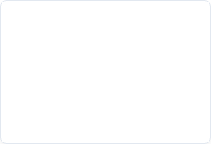
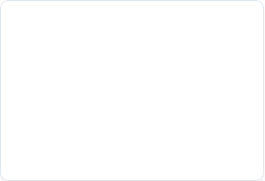

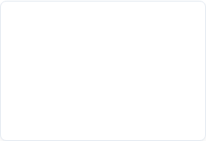
Feasibility and Project Plan
Phase 1: Architecture
Phase 3: Prediction
Requirements gathering, API Gateway setup, and decoupling monolithic endpoints into initial Microservices.
Training and deploying the Gated Recurrent Unit (GRU) models on historical task logs for timeline forecasting.
Phase 2: Matchmaking
Phase 4: Deployment
Implementation of Circuit Breakers, load testing, performance evaluation, and final system integration.
Development and integration of the Improved Genetic Algorithm (IGA) for dynamic skill-to-task allocation.

Slide 10




Conclusion & Future Work
Conclusion
Future Work
The proposed Employee Task Assignment System resolves the inherent flaws of monolithic architectures by adopting a resilient Service-Oriented Microservices mesh.
Cross-Platform Integration: Exposing the system's APIs to integrate seamlessly with third-party enterprise tools like Jira, Slack, and Microsoft Teams.
By integrating advanced programmatic phases—IGA for matchmaking and GRU for timeline prediction—the system guarantees highly optimized, context-aware workforce management with minimal downtime.
Advanced Sentiment Analysis: Incorporating NLP on employee feedback logs to adjust task assignment weights based on employee burnout and workload stress indicators.

Slide 11
Questions?
Thank you for your attention.
Employee Task Assignment System
SOA Project Review-1

